Slide 1
ME759 High Performance Computing for Applications in Engineering [Spring 2020]
Lecture 24
03/25/2020
Dan Negrut, 2020 ME759 UW-Madison

Slide 2
The quote the day
“I have never let my schooling interfere with my education.”
-- Mark Twain (more likely though, Grant Allen - Canadian science writer and novelist [1848 – 1899])

Slide 3
Things to do, for Canvas live-session
Dan: start the Canvas recording
Everybody else:
Please mute your microphone
Please ask questions (limit: two per person per lecture; after that, post on Piazza)
When you ask questions, first unmute your mic

Slide 4
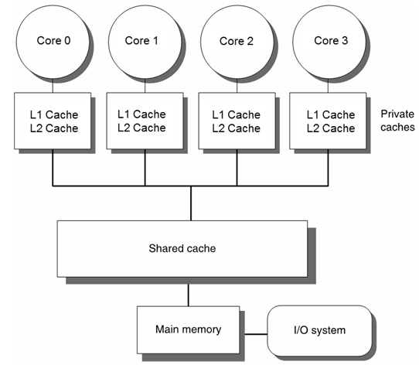
Before we get going…
Last time:
NUMA aspects, wrap up
Cache issues
Today:
Cache issues
Optimization aspects
Other tidbits:
Lectures held in Canvas Blackboard Ultra
Previous lecture recording
ME759 Exam: April 15, at 7:15 PM, in Canvas
Review: Tu, April 14, at 7:00 PM, in Canvas
Office hours moved to Canvas (same time/date)
Assignment due on Th, 9 PM
Final Project Proposal due on Friday, 9 PM

Slide 5
Cache Coherence, in ME759 – disclaimer
We discuss cache coherence just to better understand how OpenMP gets impacted
No deep dive, by any stretch of imagination
Cache Coherence: ongoing research topic, particularly for large core counts
Courses both in Electrical & Computer Engineering and in Computer Sciences

Slide 6
Caches and Coherency, bottom line
Speeding up sequential computing accomplished through use of large caches
Note that each OpenMP thread actually does engage in sequential computing
Caching consequence: multiple copies of a physical memory location may exist at different hardware locations
For program correctness, caches must be kept coherent

Slide 7
Cache Coherence: Why is this relevant for OpenMP?
When it comes to the code below, OpenMP is butchering the cache
Below, assume N=1,000,000 and 32 threads
#pragma omp parallel for
for (int i = 0; i < N; i++) {
#pragma omp atomic
a++;
}

Slide 8
Caches Coherence Mechanisms
Cache coherence (CC) doesn’t come for free
Significant overhead associated with implementing CC
One of the main reasons why OpenMP doesn’t scale
Two established approaches for enforcing cache coherence
Directory-based
Snooping-based

Slide 9
Cache Coherence Mechanisms: Directory-Based [1/2]
Encountered in systems with large core counts
Example: Intel Xeon Phi 7290, had 72 core count (chip now discontinued)
Builds on the assumption that there is a fast point-to-point connection between the cores
Employs a directory that indicates which data is stored by which core’s cache
You can think of this directory as something similar to the Page Table that we introduced when discussing the concept of Virtual Memory
Keep in mind that this directory is not overwhelmingly large (caches are not that large)
Pros: scales better than the snooping-based alternative
Cons: complex, relatively low time overhead (“relatively”: compared to the alternatives; still very costly)

Slide 10
Cache Coherence Mechanisms: Directory-Based [2/2]
Directory typically split into pieces; each piece stored by one core
Each mem. transaction needs to consider the possibility of invalidating a cache line in some other core’s cache
CC becomes particularly taxing if you have NUMA architectures
NOTE: Ultimately, it’s not OpenMP’s fault
Taxing overhead for CC: interplay between the underlying hardware and the shared memory model embraced on the multi-core CPU

Slide 11
Cache Coherence Mechanisms: Snooping/Sniffing-Based
Encountered in systems with small core counts
Builds on the assumption of a front-side bus; i.e., all memory transactions initiated by any core are processed through one connection/junction to the system memory
Pros: simple
Cons: doesn’t scale
Snooping happens here

Slide 12

MESI Protocol: Example of Snooping-Based Cache Coherence Protocol

Slide 13
MESI: Invalidation-Based Coherence Protocol
Cache lines have state bits used to characterize state of one cache line
MESI Protocol has four states: M: Modified, E: Exclusive, S: Shared, I: Invalid
Processor A’s Cache
Processor B’s Cache
zz
1. Read variable “zz”
I→E
“exclusive”
zz
zz
E→S
I→S
2. Read variable “zz”
“shared”
“shared”
zz
3. Write variable “zz”
S→M
S→I
Cache line
is invalidated
“modified”
“invalid”
[J. Marathe]→

Slide 14
The four states in which a cache line (CL) can find itself
Modified (M)
CL present only in the current cache, and is dirty; i.e., there’s discrepancy w.r.t. what’s in main memory
Cache required to write the data back to main memory at some time in the future, before permitting any other read of the (no longer valid) main memory state
NOTE: The write-back changes the CL to (S)
Exclusive (E)
CL present only in the cache and it’s clean; i.e., it matches what’s in main memory
NOTE: Might change to (S) in response to a read request. Might change to (M) when writing to it
Shared (S)
CL may be stored in other caches of the machine and is clean; i.e., it matches what’s in main memory
NOTE: The CL may be discarded; i.e., changed to (I), at any time.
Invalid (I)
CL is invalid; i.e., it should not be used

Slide 15
Example: Possible state combinations (✔), for a pair of caches
Core 0
Core 1
System can’t be M & M (that’d be too sweet)
One cache can be I while the other one is M
One cache can be S while the other is S
System can’t be E & E
Etc.
Main Memory
 | M | E | S | I
M | x | x | x | ✔
E | x | x | x | ✔
S | x | x | ✔ | ✔
I | ✔ | ✔ | ✔ | ✔

Slide 16

Coherency – Simplified Further [cooked up example]
Further simplify MESI for sake of simple discussion on next slide
Assume now that each cache line can exist in one of 3 states:
Exclusive: the only valid copy in any cache
Read-only: a valid copy but other caches may contain it
Invalid: out of date and cannot be used
In this simplified coherency model
A READ on an invalid or absent cache line will be cached as read-only or exclusive
A WRITE on a line not in an exclusive state will cause all other copies to be marked invalid and the written line to be marked exclusive
[Alan Real]$→$

Slide 17
Cache coherency cartoon
Exclusive
Read-Only
Invalid
W
P
R
P
W
P
P
R
L1C
L1C
L1C
L1C
L2C
L2C
L2C
L2C
Interconnect
Memory
[Alan Real]→

Slide 18
[new sub-topic]Preamble: the “false sharing” issue in OpenMP
(below, assume a, and b, and c are arrays of float-type variables)
#pragma omp parallel for schedule(dynamic,2)
for (int i = 0; i < N; i++) {
c[i] = a[i] + b[i];
}

Slide 19
The “False Sharing” Pitfall
Recall cache lines typically are 64 byte long
Can store, for instance, 8 double precision values or 16 integers
IMPORTANT NOTE: as soon as one entry in a cache line is changed, all the other values in cache line get dirty
False sharing: happens when two threads are both writing into different locations within the same cache line
One write by Processor A will invalidate the cache line on Processor B
Memory transactions galore, tied to the cache coherence requirement

Slide 20
False Sharing: symptoms
Poor performance
High, non-deterministic numbers of cache misses (particularly if NUMA comes into play)
Mild, non-deterministic, unexpected load imbalance

Slide 21
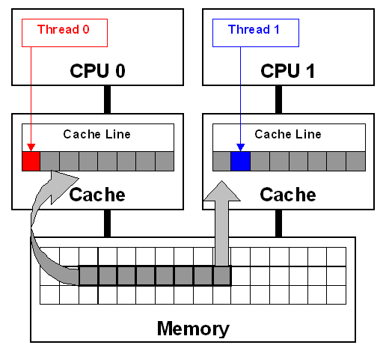
False Sharing Example [1/2]
double sum_local[8];
double sum = 0.0;
#pragma omp parallel num_threads(8)
{
int me = omp_get_thread_num();
sum_local[me] = 0.0;
#pragma omp for
for (i = 0; i < N; i++)
sum_local[me] += x[i] * y[i];
#pragma omp atomic
sum += sum_local[me];
}
How can this instance of false sharing be fixed?
[IOMPP]→

Slide 22
False Sharing Example [2/2]
Easy fix: use reduction(+,sum)
Look into other alternatives
Basic idea, use private/local variables
Fall back on “false sharing” only once, at the end

Slide 23
Sometimes This Fixes It
Reduce the frequency of false sharing by using thread-local copies of data
The thread-local copy will be read and modified frequently
When complete, copy the result back to the data structure
struct ThreadParams {
// For the following 4 variables: 4*4 = 16 bytes -> fits in one cache line…
unsigned long thread_id;
unsigned long v; // Frequently accessed variable (for reads/writes)
unsigned long start, end;
};
void threadFunc(void *parameter) {
ThreadParams *p = (ThreadParams *)parameter;
// local copy for read/write access variable
unsigned long local_v = p->v;
for (unsigned long local_dummy = p->start; local_dummy < p->end; local_dummy++) {
// Functional computation, would read/write the “v” member.
// Keep reading/writing local_v instead
}
p->v = local_v; // Update shared data structure only once
}
[IOMPP]→

Slide 24
Another Way to Fix This [Ugly + Architecture Dependent]
When using an array of data structures, pad the structure to the end of a cache line to ensure that the array elements begin on a cache-line boundary
If you cannot ensure that the array is aligned on a cache line boundary, pad the data structure to twice the size of a cache line
struct ThreadParams {
// For the following 4 variables: 4*4 = 16 bytes
unsigned long thread_id;
unsigned long v; // Frequent read/write access variable
unsigned long start, end;
// expand to 64 bytes to avoid false-sharing
// (4 unsigned long variables + 12 padding)*4 = 64
int padding[12];
};
__declspec(align(64)) struct ThreadParams Array[10];
[IOMPP]→

Slide 25
OpenMP, departing thoughts
The cornerstone of OpenMP was the concept of parallel region: omp parallel
However, rarely does a parallel region witness all threads executing the same code
Why?
The parallel region construct was qualified via other OpenMP directive that changed the interplay between the code and the threads:
for
sections
single
task
critical

Slide 26
OpenMP: What Speedup Should You Expect?
For N cores, to get a speed-up of a factor of N is rare
Problem should be embarrassingly parallel, and you should not max out mem bandwidth (you need high arithmetic intensity, that is)
In general scaling doesn’t materialize beyond a certain core count
CC overhead
Limited amount of main memory bandwidth
Synchronization demands on the part of the algorithm you implement
NUMA collateral damage
Question: Is fewer fat chips better than more slim chips?
slim/fat: higher/lower core count per chip

Slide 27
Parallel computing: GPU CUDA vs. OpenMP
A CUDA kernel is like an OpenMP parallel region without embellishments such as for, single, task, etc.
All CUDA/OpenMP threads execute the code in the kernel/parallel region, respectively
Caveat, CUDA: parallel execution proceeds in lock-step fashion* (for the threads in a warp, that is)
Reflect on the advantages and disadvantages of the memory ecosystem/memory operation when you compare GPU and OpenMP parallel computing

Slide 28
Critical Thinking in Code Design/Development, with an Eye Towards Improving Performance

Slide 29
Back of the envelope, ME759 opportunities for efficiency gains
Use of right compiler flags, ILP-friendly code, etc. [discussed in this segment]
Speed up factor: 2X
Inspired use of cache [already discussed this]
Speed up factor: 2-3X
Use of vectorization (AVX2/AVX512) – use mips in OpenMP parallel for [discussed before, touched upon in this segment]
Speed up factor: 1.2X
Use of multiple cores [already discussed this, OpenMP]
Speed up factor: 5 – 6X
If the planets align, ME759 knowledge should help you to gain a 30X speed up factor

Slide 30
Motivation, ME759 segment on “critical thinking/code optimization”
Understanding how things work under the hood can translate into improved performance
(to that end, we’ll hit on various ME759 aspects)

Slide 31
Acknowledgement
Some slides in this segment come from
Material from class 15-213 at CMU
Nathan Bell (while he was at NVIDIA)
Georg Hager, Jan Eitzinger, Gerhard Wellein – material presented at Supercomputing 2019
Matt Godbolt, maker of Compiler Explorer

Slide 32
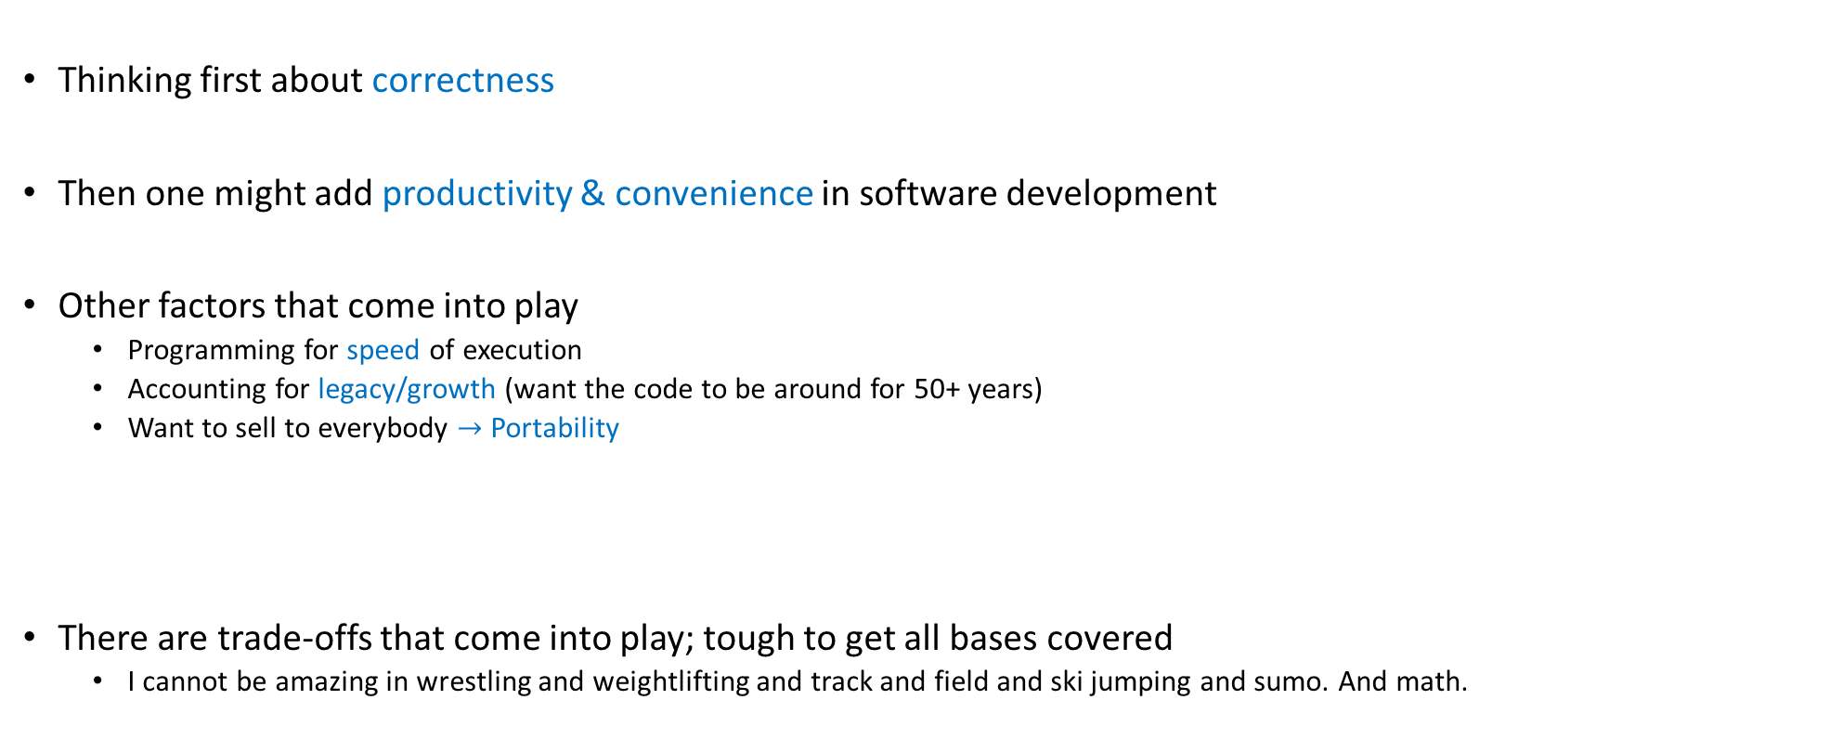
Mindsets, approaching software development
Thinking first about correctness
Then one might add productivity & convenience in software development
Other factors that come into play
Programming for speed of execution
Accounting for legacy/growth (want the code to be around for 50+ years)
Want to sell to everybody $→$ Portability
There are trade-offs that come into play; tough to get all bases covered
I cannot be amazing in wrestling and weightlifting and track and field and ski jumping and sumo. And math.

Slide 33
Angle of attack, this module
Our end goal: write faster programs, to handle large datasets fast
Focus of the discussion
Particularly relevant when your code runs on the CPU; thus, for OpenMP code
However, some lessons carry over to the GPU as well

Slide 34
Angle of attack, this module
Module brings together concepts we’ve covered thus far; i.e., knowledge about:
Compilers, and how they work [covered mostly in ME459, we’ll further elaborate on this]
Memory aspects: pointers, hierarchy, latencies, bandwidths
Instruction level parallelism (pipelining, jump instructions, branch prediction, etc.)
We’ll use a couple of examples to show how a) through c) above come into play
The hope is that the points made in these example will help you down the road

Slide 35
Assessing performance, common sense things to keep in mind
Second quote of the day: “You can't manage what you can't measure.”
Peter Drucker -- Austrian-born American management consultant, educator
Timing and profiling needed to measure the performance of your code
Issue 1: make sure you understand the level of resolution of your timers
Example: if your code runs in 1 millisecond, your timer’s level of resolution should be at least 1 microsecond
Issue 2: steep learning curve to get to point where you get return on investment for profiling

Slide 36
Assessing performance, common sense things to keep in mind
Find out where the bottleneck of the execution is. Time/profile heavily that part
Almost always this is tied to some loop; hopefully, you have control over what happens in that loop
Try to understand how execution time is split between “user time” and “system time”
There is nothing that you can do about the speed of printf
There is nothing that you can do if the “user time” for your program is 10%

Slide 37
Assessing performance, common sense things to keep in mind
Measure repeatedly to get statistical data about your program’s execution time
Timers: command-line timers or code-embedded timers
“command-line timers”: you measure the time it takes the OS to load your program from disk into memory, launch it, and then execute it
You care about the execution time only
Bottom line: when given a choice, prefer “code-embedded timers” to “command-line timers”
NOTE: if you measure repeatedly, your code is not going to be brought over from disk
Thus, you’re not going to have a “cold start” if you measure repeatedly

Slide 38
Assessing performance, common sense things to keep in mind
“cold start” also applies to loading data into memory
Example:
Suppose your program uses 40 KB of data
This would fit in L1 cache, on a quiet machine with a decent chip
40KB of data:
It can be buried on the disk since you haven’t used it since last year: cold start
It can be already in L1 since you run your code 1000 times to get statistical info about run times: hot start
Thus, if you measure repeatedly, your data is not going to be brought over from disk
In other words, you’re not going to have a “cold start” if you measure repeatedly

Slide 39
Assessing performance, common sense things to keep in mind
“quiet machine”
Recall difference between “wall-clock time” and “execution time”
Good idea to time on a quiet machine
Alternative 1: You are one of 40 programs running, and you do so at some sad priority level
Alternative 2: Other than the kernel, you are perhaps the only show in town, on that machine

Slide 40
Assessing performance, common sense things to keep in mind
In general, if you are assessing performance for improving speed, carry out timing/profiling exercise on the platform/chip on which you’ll be running the code
Assessing & improving performance for on a Windows machine w/ Microsoft compiler and a fat Intel chip with large caches will produce different results than running gcc-compiled code on Raspberry Pi w/ Linux

Slide 41
Rules of the thumb, squeezing performance out of solution
Think critically about the code you’re writing
Get to know your hardware: core count, how much memory, what latencies, bandwidth, etc.
Write compiler-friendly code [more to come, on this topic]
Watch out for optimization blockers; i.e., procedure calls & memory references
Look carefully at innermost loops (where most work is done)
Choose the right algorithm for your problem

Slide 42
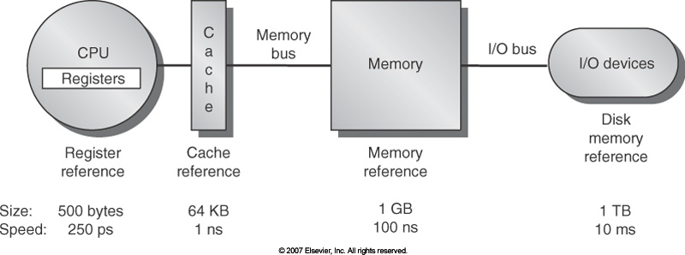
Know your memory latencies [typical embedded, desktop, and server computers]
[Computer Architecture, Hennessey and Patterson, fourth edition]$→$
Notes:
These numbers are by now obsolete, but orders of magnitude still relevant.
What does this imply?
For a frequency of 2GHz, 100ns for a memory access translates into 200 cycles.
But in one single cycle, a multi-core CPU, e.g. AMD Intralagos, can perform 32 fused multiply-add (FMA).
Conclusion: performance is dictated by efficiency of memory transactions <-> number crunching is free.
Goal: try to keep data in cache. You cannot directly control this, but you can arrange your code to provide good temporal and spatial locality.

Slide 43
Know your Bandwidths in your system
Latency:
Low
GPU cores
CPU Core
Cache
NOTE: The width of the black lines is proportional to the bandwidth.
80GB/s
50-100
GB/s
1000
GB/s
Latency:
Medium Low
Latency:
Rel.Low
System Memory
GPU Memory
Infiniband to next Compute Node
6GB/s
8-16 GB/s
Latency:
High
Latency:
Medium

Slide 44
Thinking critically about the expected speedup outcome
Dealing w/ Big Data: You are trying to optimize your code for speed
What makes for a good speed-up? What would make you happy?
1.2X speedup?
1.5X speedup?
2X speedup?
10X speedup?
Answer depends on how polished the code is when you pick it up
Rule of thumb in engineering: if your job finishes overnight, it’s most often ok
“Job”: might be running a long program once, or running a short one a million times
“Job”: something that when completed produces data that yields information that leads to knowledge that produces insights that assist your decision making

Slide 45
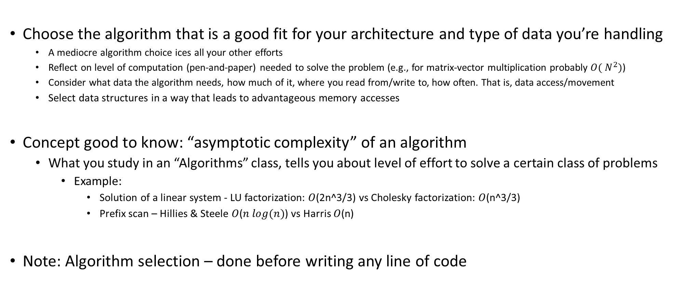
Starting off on the right foot: choose the right algorithm
Choose the algorithm that is a good fit for your architecture and type of data you’re handling
A mediocre algorithm choice ices all your other efforts
Reflect on level of computation (pen-and-paper) needed to solve the problem (e.g., for matrix-vector multiplication probably $O({ N}^{2})$)
Consider what data the algorithm needs, how much of it, where you read from/write to, how often. That is, data access/movement
Select data structures in a way that leads to advantageous memory accesses
Concept good to know: “asymptotic complexity” of an algorithm
What you study in an “Algorithms” class, tells you about level of effort to solve a certain class of problems
Example:
Solution of a linear system - LU factorization: $O$(2n^3/3) vs Cholesky factorization: $O$(n^3/3)
Prefix scan – Hillies & Steele $O$($n log(n)$) vs Harris $O$(n)
Note: Algorithm selection – done before writing any line of code

Slide 46
Starting off on the right foot: choose the right algorithm
When working on problem, there’s more to performance than asymptotic complexity
Why?
Because asymptotic complexity is most often defined by number of operations
Memory transactions are rarely considered – they are specific to the hardware you’ll eventually use to run
If you understand how the computer works, it can guide you in designing a good/fast solution
Indeed, there is hope:
A problem can be solved by many algorithms (or approaches)
Also, one algorithm can have many implementations
Spend time reflecting on your solution before writing any line of code!

Slide 47
Asses the “Arithmetic Intensity” associated w/ your problem
Arithmetic intensity: how much math you do per byte of data you bring from memory
You can be in one of three cases:
Case 1: compute bound
That is, high arithmetic intensity – the ALU works a lot, not a whole amount of data movement to/from memory
Case 2: memory bound
You are moving data back and forth, likely only small parts of the data moved gets changed and/or used
Think cache misses
Case 3: “middle-earth” (J. R. R. Tolkien)
Somewhere in between compute-bound and memory-bound.
Your mission in this case: Try to move to Case 1 or Case 2 above

Slide 48
Arithmetic Intensity: Putting things in perspective
J. R. R. Tolkien’s “Middle-earth”
Memory bound
Compute bound
FLOP/Byte
SAXPY
FFT
SGEMM (matrix-matrix multiplication)

Slide 49
Simple Optimization Technique: Fusing Transformations
One way to move the needle from “memory bound” towards “compute bound”
Basic idea
Do not bring data into cache twice
If you use data X, Y, and Z – bring this data from memory once and then forget about it
Why is it better?
You avoid memory traffic
for (int i = 0; i < N; i++)
U[i] = F(X[i],Y[i],Z[i]);
for (int i = 0; i < N; i++)
{
U[i] = F(X[i],Y[i],Z[i]);
V[i] = G(X[i],Y[i],Z[i]);
}
for (int i = 0; i < N; i++)
V[i] = G(X[i],Y[i],Z[i]);
Loop Fusion
Notes:
So what can we do to maximize the work we do for the same amount of data transferred?
Simple idea… But powerful

Slide 50
Fusing transformations on previous slide
Original implementation
More thoughtful implementation
12 Bytes
4 Bytes
12 Bytes
12 Bytes
8 Bytes
CPU
4 Bytes
Mem
CPU
Mem
Memory traffic cut by a factor of 1.6 (=32/20)
Notes:
What does this fusing get us?
Since the operation is completely memory bound the expected speedup is ~1.6x (=32/20)

Slide 51
Fusing Transformations
for (int i = 0; i < N; i++)
Y[i] = F(X[i]);
for (int i = 0; i < N; i++)
sum += F(X[i]);
for (int i = 0; i < N; i++)
sum += Y[i];
Loop Fusion
Mem traffic cut by a factor of 3
Less memory used (no need to have Y)
NVIDIA [N. Bell]→
Notes:
Another example of loop fusion

Slide 52
Fusing Transformations in Previous Example
Original Implementation
Optimized Implementation
4 Bytes
4 Bytes
4 Bytes
4 Bytes
CPU
DRAM
CPU
DRAM
TAKE AWAY MESSAGE: Think if you can reduce in your code data movement since it is expensive:
Power costs
Time waiting for data to move around
Notes:
Since the operation is completely memory bound the expected speedup is ~3x (=12/4)
The numbers of bytes are showing what happens for each i, from i=1 to 3 (or lengths of array)

Slide 53
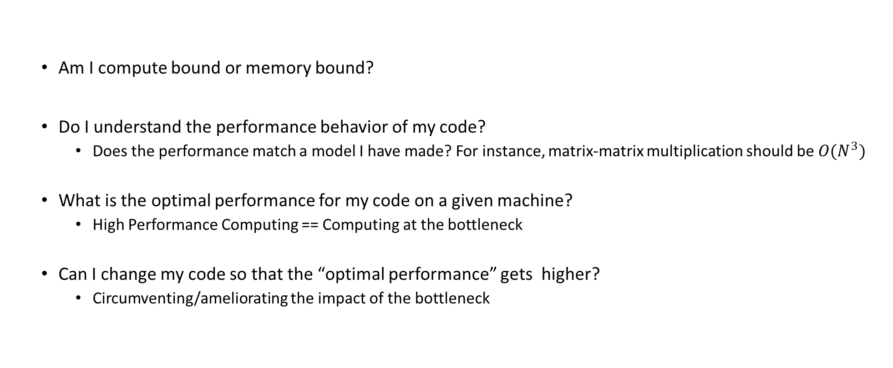
High Performance Computing: Questions to Ask
Am I compute bound or memory bound?
Do I understand the performance behavior of my code?
Does the performance match a model I have made? For instance, matrix-matrix multiplication should be ${O(N}^{3})$
What is the optimal performance for my code on a given machine?
High Performance Computing == Computing at the bottleneck
Can I change my code so that the “optimal performance” gets higher?
Circumventing/ameliorating the impact of the bottleneck

Slide 54
Outside the scope of course: The roofline model
I encourage you to read about the “roofline model” to assess code performance
“Are you compute bound?” ; “Am I memory bound?” ; “What chip/architecture might help me?”
Access here “roofline model” material from Supercomputing 2019

Slide 55
Let’s talk about the compiler…
When you time/profile your code, you’ll have to play with the compile flags
Execution speed impacted heavily by compiling flags (3-4X speedup)
NOTE: Aggressive optimization done by compiler might change behavior of your code
Might change results
Might uncover skeletons in the closet
Side note: fair run-time comparisons is tricky
Different compilers have different flags
Tons of compilers out there: gcc, clang, g++, icl, cl, xl, etc.
Some compilers very adept at leveraging the underlying processor

Slide 56
How compilers come into play
A compiler has a tough job
Register allocation
Instruction selection and ordering
Dead code elimination
Fix minor inefficiencies
The expectation is that the compiler will provide an efficient mapping of program to machine
Compilers may or may not support features that have been included in a language recently (C++11, C++14, C++17, C++20, C++23, etc.)
Something to think about:
At least in theory, Intel compiler ought to be best positioned when it comes to compiling code for Intel chips
It ought to know all the dark corners of the microarchitecture
Well positioned to first implement any new/exotic ISA features

Slide 57
How compilers come into play
Compilers don’t improve asymptotic efficiency of your algorithm
Up to programmer to select the right algorithm for the problem & the architecture
Compilers have difficulty overcoming “optimization blockers”
Potential memory aliasing
“function call” side-effects

Slide 58
The compiler has a tough job
Often, compiler ends up doing analysis only at the function level
Newer versions of gcc do inter-procedural analysis within individual files
Whole-program analysis for some reason not done too often
More on this later
int functionFromOtherFile(double*);
double someOtherRemoteFunc(double*);
double myFunc() {
const size_t N = 1024;
double foo[N];
double accumulator = 0.;
for (int i = 0; i < functionFromOtherFile(foo); i++) {
accumulator += someOtherRemoteFunc(foo);
}
return accumulator;
}
Compiler in a tough spot: function bodies are often hidden from call sites, compiler can only see their declaration

Slide 59
The compiler has a tough job
The compiler operates under tight constraints
It must obey all the rules in the C/C++ standard
Often prevents compiler from making optimizations that would only affect behavior under pathological conditions
Rule above possibly ignored though when your code is making use of nonstandard language features
This is what gets the compiler confused and it needs to play it super safe so that you are not mad at it
Behavior that may be obvious to the programmer can be obfuscated by coding styles and poor understanding of the language
Use of pointers is a big stumbling block

Slide 60
The compiler has a tough job
Most analysis based only on static information
Compiler can’t anticipate run-time inputs (in general)
One way in which we don’t help compilers is by writing code that is ambiguous, open to interpretation
The compilers can’t read our minds
When in doubt, the compiler must be conservative

Slide 61
Tricks of the trade, done by compiler
Function inlining – this is a big one
Wherever you call a function, the compiler simply replaces the call to function foo with the entire body of function foo (the entire function body dropped in)
Not always possible, you must explicitly call for it (by function decoration and/or compile flags)
Nowadays you can ask the compiler to report back what functions it successfully inlined
Consequences, if you can inline:
You have one less jump
More important: the compiler sees way more code and therefore engages in more fruitful optimizations
It’s one thing to optimize when you have 5 lines of code, and a different one for 500 lines of code
[Matt Godbolt]$→$

Slide 62
Other tricks of the trade, done by compiler
Constant propagation
Compiler substitutes all references to myApplePie with the constant value
Common subexpression elimination
Dead code removal
There may be areas of the code that have no effect on the output, and these can be removed
This includes loads and stores whose values are unused, as well as entire functions and expressions
Tail call removal
Set of recursive calls to same function get replaced by a loop
const double myApplePie = 3.1415;

Slide 63
How can you help the compiler?
A) Allow it to see as much code as possible
You set it free, so to speak
Recall that typically compiler sees only one file at a time
Can’t peek at some function you use that is defined in a different file
B) Provide flags to convey to it information
E.g.: telling compiler your target architecture can help a lot

Slide 64
Compilers, and link time optimization (LTO)
Compilers are becoming faster and smarter
It’s affordable and profitable to do program-level, not function level optimization
LTO (also known as LTCG, for “link time code generation”) can be used to allow the compiler to see across translation unit boundaries
Likely to provide good speed up for complex codes with many source files

Slide 65
Compilers, and link time optimization (LTO)
Individual translation units are compiled to an intermediate form instead of machine code
During the link process—when the entire program is visible—machine code is generated
The compiler can take advantage of this to inline across translation units, or at least use information about the side effects of called functions to optimize
NOTE: Invoking LTO can be done today; controlled through compile flags

Slide 66
Other tricks pulled off by the compiler [called “strength reduction”]
for (int i = 0; i < 100; ++i)
{
func(i * 1234);
}
You wrote this:
This is what the compiler will generate on your behalf:
for (int iTimes1234 = 0; iTimes1234 < 100 * 1234; i += 1234)
{
func(iTimes1234);
}
[Matt Godbolt]$→$

Slide 67
One common theme for speeding up code: code motion
Code Motion
Reduce frequency with which some computation is performed
Particularly rewarding when a piece of code can get moved out of a loop
Typically done by the compiler, under higher optimization levels – if this is possible (more later)
Caveat: Make sure the new code produces same result (if you, rather than the compiler goes for it)
Code motion, basic idea, captured in this code snippet:
void set_row(double *a, double *b, int i, int n) {
for (int j = 0; j < n; j++)
a[n*i + j] = b[j];
}
void set_row(double *a, double *b, int i, int n) {
int dummy = n * i;
for (int j = 0; j < n; j++)
a[dummy + j] = b[j];
}
Typically done by compiler, if no red flags encountered

Slide 68
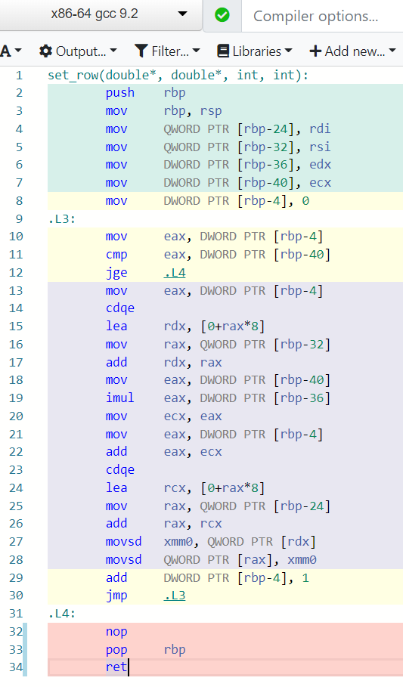
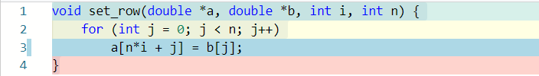

Assembly code, no optimization
See line 3 (left) and line 19 (right)
[https://godbolt.org/]$→$

Slide 69
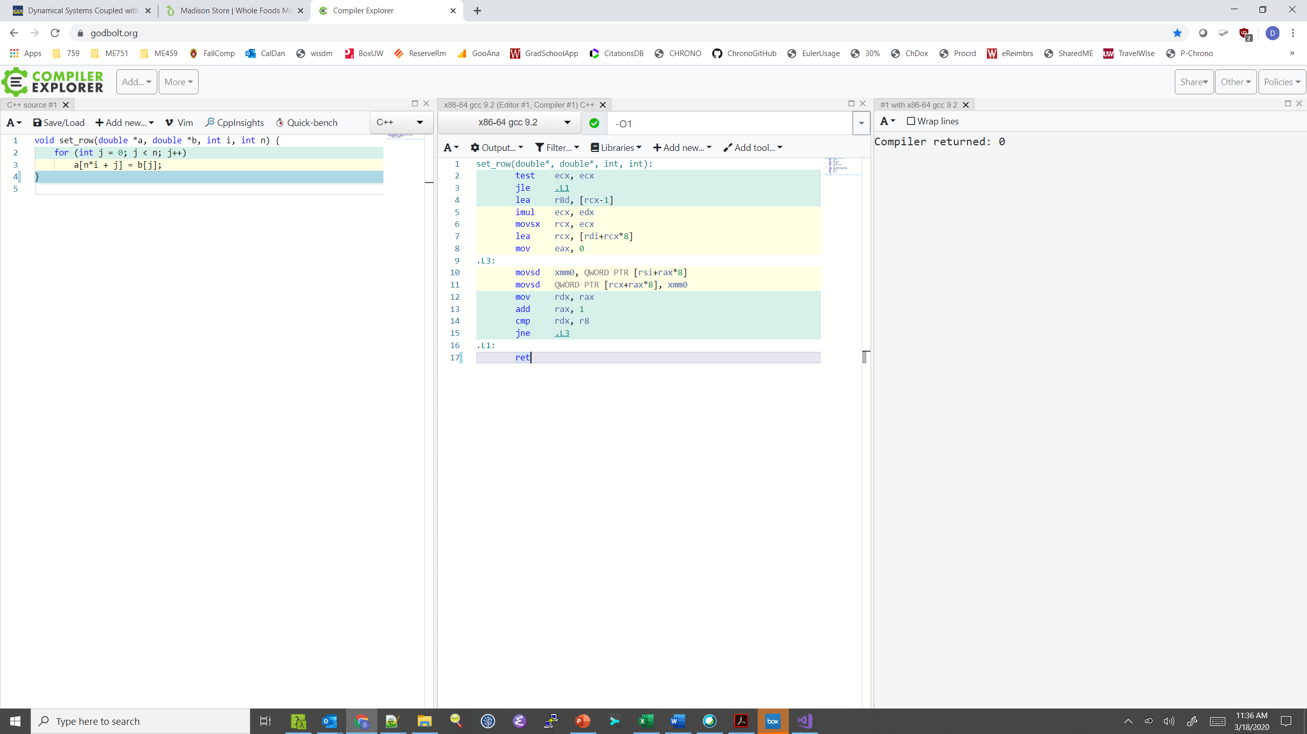
Assembly code, optimization –O1
Multiplication moved out of loop by compiler!
Take home message: the compiler tries hard to help you
[https://godbolt.org/]$→$

Slide 70
[Next thing to consider:] Function calls are optimization blockers
Procedure to Convert String to Lower Case
void lower(char *s)
{
size_t i;
for (i = 0; i < strlen(s); i++)
if (s[i] >= 'A' && s[i] <= 'Z')
s[i] -= ('A' - 'a');
}
[15-213 @ CMU]$→$

Slide 71
Convert Loop To Goto Form [first order approx. for assembly]
strlen executed at every iteration (for a total of N times, if number of chars in s is N)
void lower(char *s) {
size_t i = 0;
if (i >= strlen(s))
goto done;
loop:
if (s[i] >= 'A' && s[i] <= 'Z')
s[i] -= ('A' - 'a');
i++;
if (i < strlen(s))
goto loop;
done:
}
[15-213 @ CMU]$→$

Slide 72

Calling strlen
strlen performance
Only way to determine length of string is to scan its entire length, looking for null ‘\0’ character
What’s the impact of this?
N calls to strlen
Each call runs loop over N elements to find ‘\0’
Overall O(N²) performance
/* My version of strlen */
size_t strlen(const char *s)
{
size_t length = 0;
while (*s != '\0') {
s++;
length++;
}
return length;
}
[15-213 @ CMU]$→$

Slide 73
Lower Case Conversion Performance: version V1
Time quadruples when double string length
Quadratic performance
lowerV1
[15-213 @ CMU]$→$

Slide 74
Improving Performance
Move call to strlen outside of loop
Since result does not change from one iteration to another
Perform “code motion”
void lower(char *s)
{
size_t i;
size_t len = strlen(s);
for (i = 0; i < len; i++)
if (s[i] >= 'A' && s[i] <= 'Z')
s[i] -= ('A' - 'a');
}
[15-213 @ CMU]$→$

Slide 75
Lower Case Conversion Performance: version V2
Time doubles when double string length
Linear performance of lower2
lowerV1
lowerV2
[15-213 @ CMU]$→$

Slide 76
Optimization Blocker: Procedure Calls
Why couldn’t compiler move strlen out of inner loop?
A function may have side effects
e.g., alters global state each time called
Function may not return same value for given arguments
e.g., depends on global state (for instance, in multi-core parallelism)
The takeaway message
Compiler treats procedure call as a black box
Weak optimizations near/around procedure call (stumbling block)
Remedies:
Do your own code motion
C++: Use of inline functions
GCC does this with –O1
Within single file
size_t lencnt = 0;
size_t strlen(const char *s)
{
size_t length = 0;
while (*s != '\0') {
s++; length++;
}
lencnt += length;
return length;
}
In this example, each time this strlen is called a variable is incremented (cooked up, but makes a point)
[15-213 @ CMU]$→$

